Slide 1
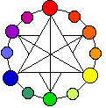
Develop
Mix at least 3 new colors with watercolor paints and add to the community color wheel.

Slide 2
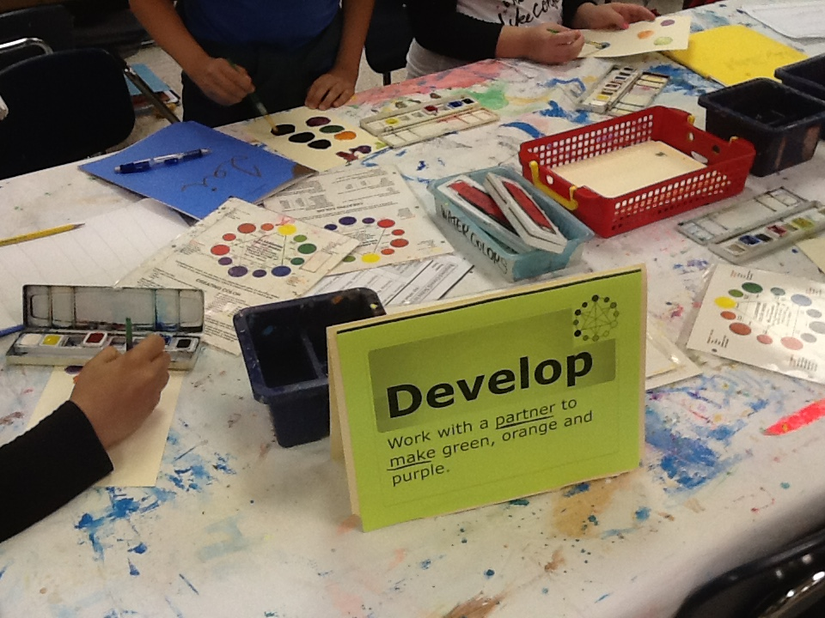

Slide 3
Explore
Spin the Spinner! Then make a sculpture based on the prompt. Use only materials at this table.

Slide 4
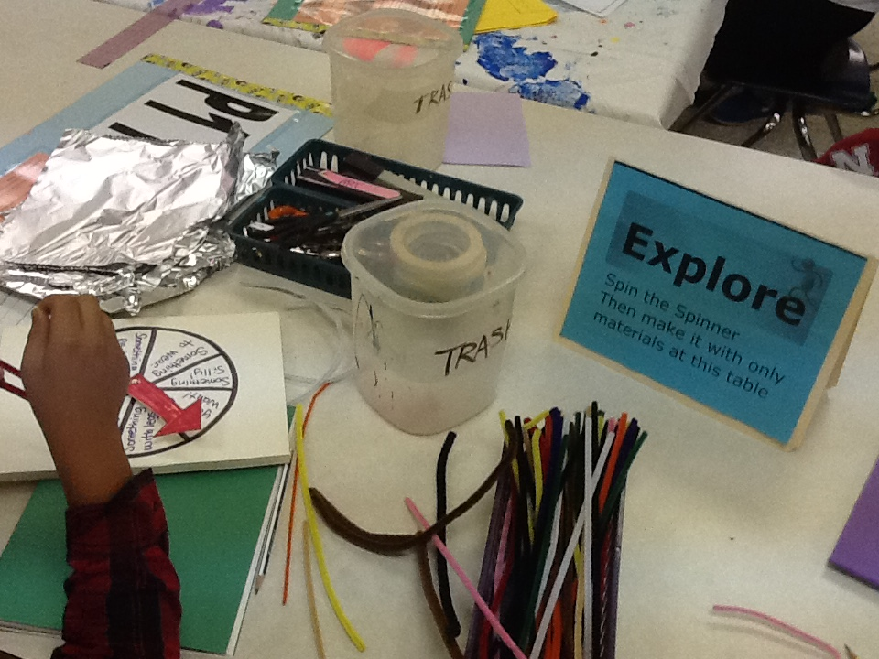

Slide 5
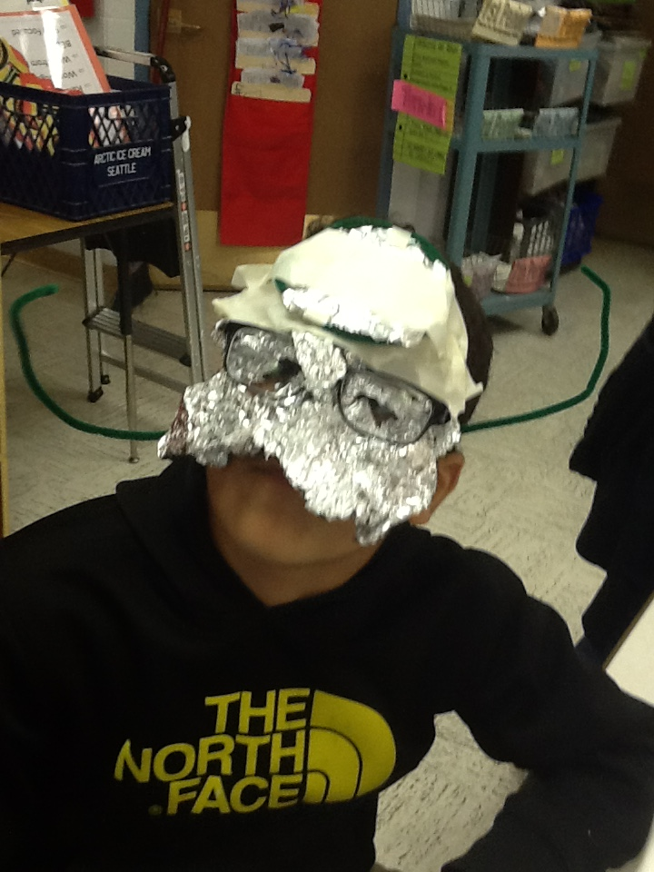
Spinner Prompt Examples
Something to wear
Something to play with
Something real
Something weird or creepy
Something musical
Something that moves

Slide 6
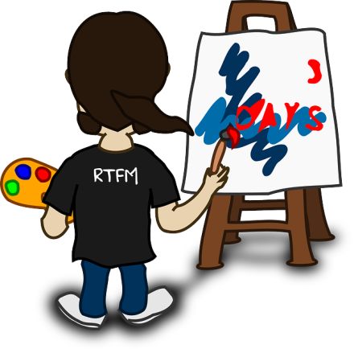
Express
Pick a word prompt from the bag. Draw it with oil pastels. Return to bag.

Slide 7
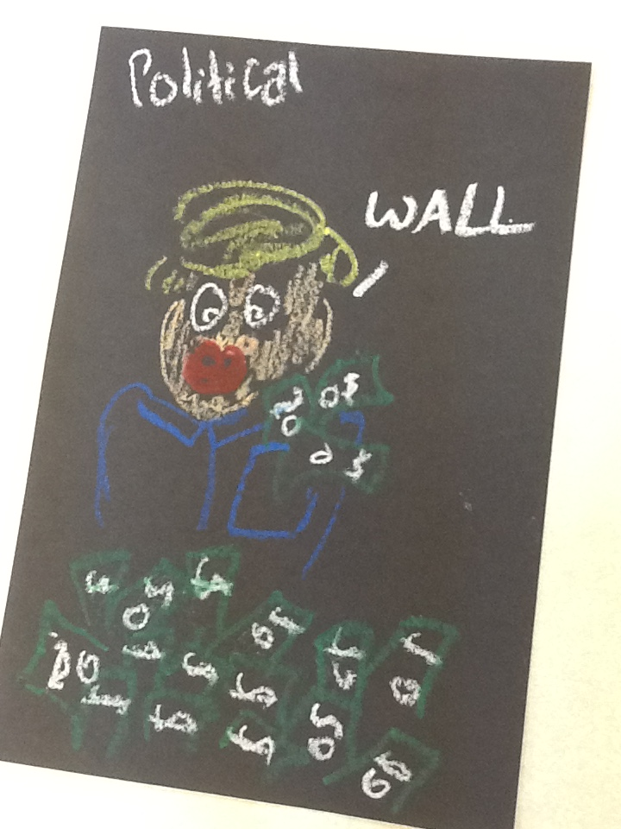
Express Prompt Examples
Political
Adventurous
Melancholy
Assertive
Flowing
Sporty
Calming
Mesmerizing
Vibrant
Swirling

Slide 8
Observe
Look at the “Eye Spy” books. List all the things you can find on one page. Try to draw at least one item in your sketchbook.

Slide 9
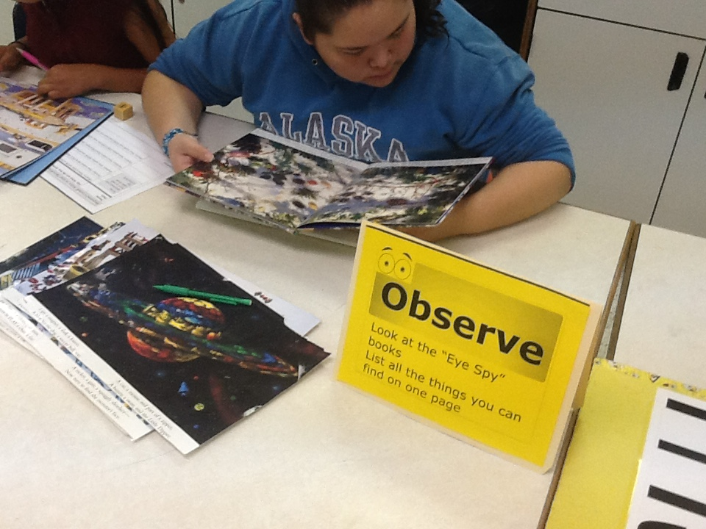

Slide 10
Envision
Pick 2 word cards from the bag. Combine them into ONE drawing use your sketch book. Return cards to bag.

Slide 11
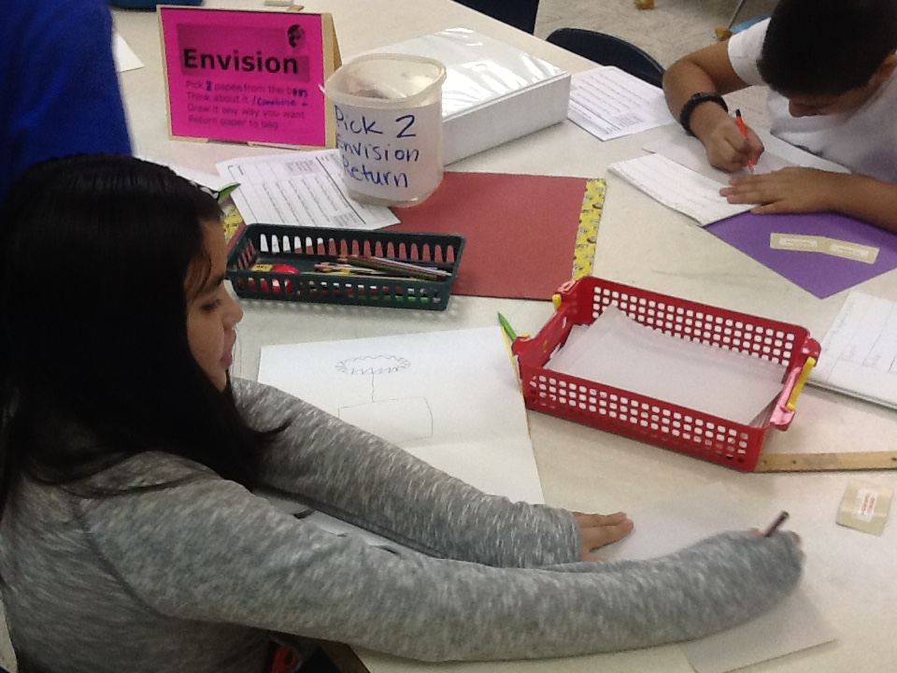

Slide 12
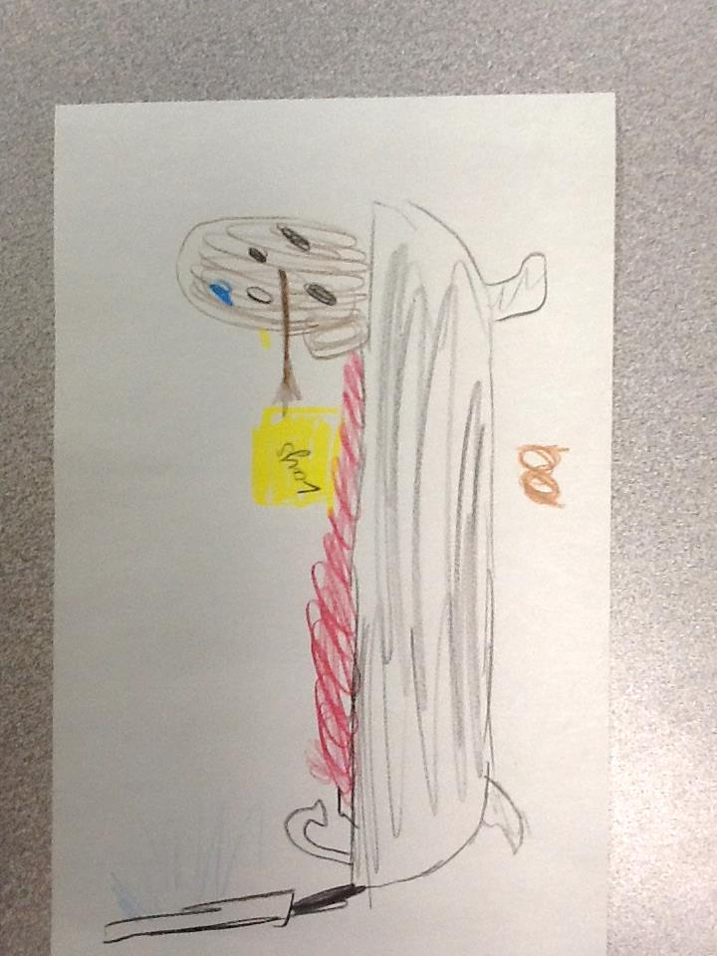
Envision Prompt Examples
Couch Potato
Blood Bath
Sun Tan
Super Man

Slide 13
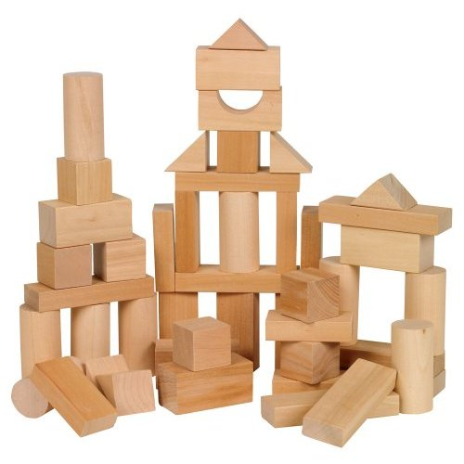
Persist
As a group build the tallest structure you can that won’t fall down. Keep trying and use all the blocks.

Slide 14
