Slide 1
Thur 02/16/2017
Sit at table 5 if NOT done with the drawing task.
Sit at table 1-4 with 2-3 friends if you ARE done with the drawing task.
Grab your object!
Supplies Needed:
Entry Task:
Pencil and sketchbook if still drawing.
Tantamounter
Copy planner info
Write in Planner:
CLEAR BINDER OFF TABLE
Activity:
Tantamounter intro
Learning Target: I can observe carefully to create a sculpture.

Slide 2
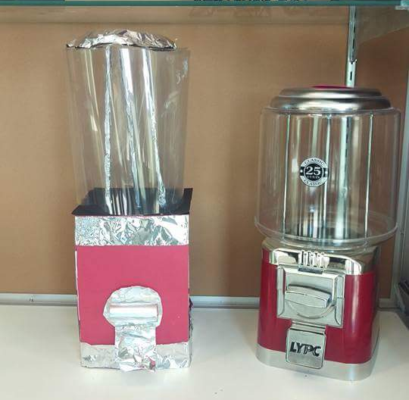

Slide 3
tan·ta·mount
adjective
equivalent in seriousness to; virtually the same as.

Slide 4
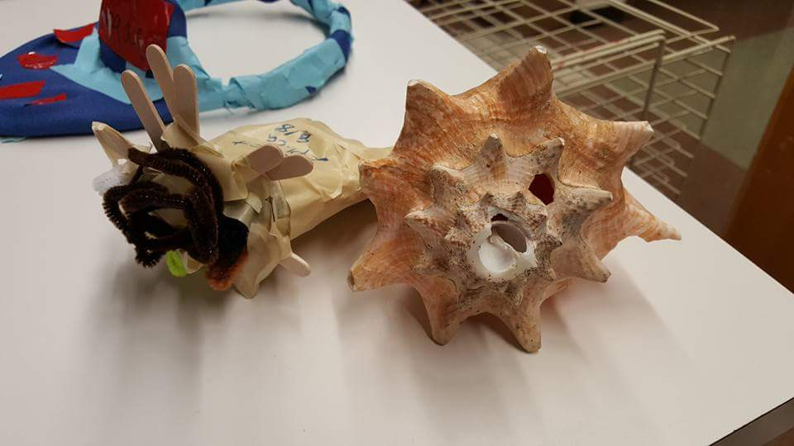

Slide 5
How to Tantamount
Pick ONE of the objects that someone in your group drew during the drawing observation unit.
MAKE a sculpture that matches that object. Do your best to make it:
The SAME SIZE
The same Color
The same TEXTURE
OK to use any supplies in the classroom (fiber, collage, drawing, paint, sculpture) JUST ASK first if it isn’t already on your table
This is a 2 period ONLY project!

Slide 6
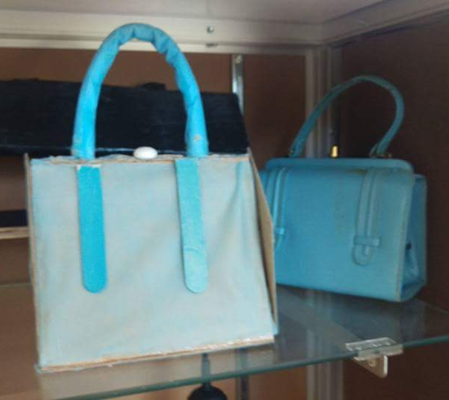

Slide 7
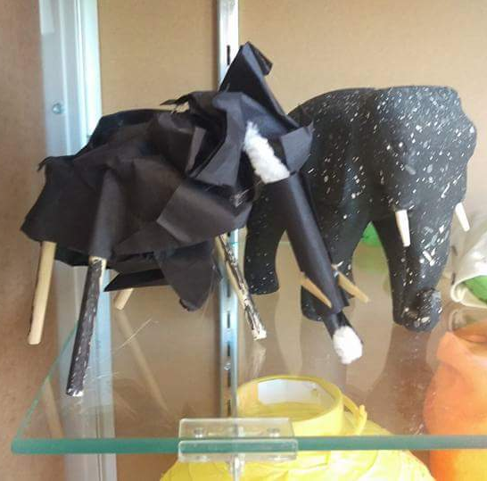

Slide 8
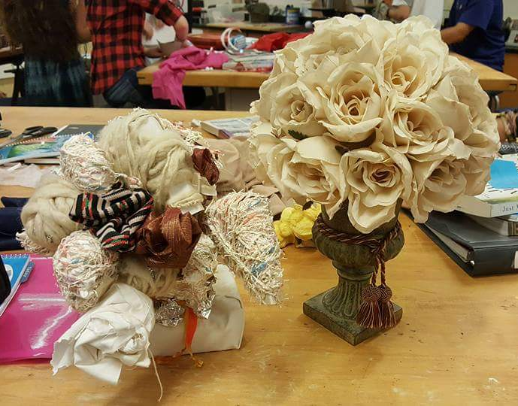

Slide 9
